Slide 1
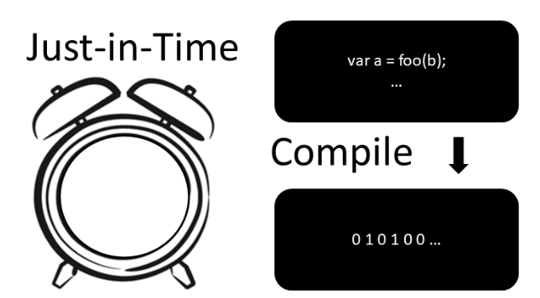
Workshop
Made by Jorge and Thijs

Slide 2
Table of contents
What is a compiler/interpreter(no laptops, only public knowledge)?
How does a compiler/interpreter work (no laptops, only public knowledge)?
What is JIT compiler?
What are the pros and cons of using jit compiler?
What are use cases for JIT compiler?
Exercises(GitHub)
Quizz
Future for JIT compiler?
Questions

Slide 3
What is a compiler/interpreter?
Source code – machine code
Lkajsdf
Lkasjdf
Lkjasdlkfj
Jlkajsdf
lkjasdf

Slide 4
How does a compiler/interpreter work?

Slide 5
What is JIT compiler?

Slide 6
What are the pros and cons of using jit compiler?

Slide 7
What are use cases for JIT compiler?

Slide 8
Exersices
In order to do the exersices provided by us, please follow the following steps:
Go to: https://github.com/sebivenlo/esd-2024-jit-compiler
Clone the repository and open VSCode
Install all Docker images using devContainer dependency(ask us if you need help)
Wait for everyone to finish the installation

Slide 9
Exercise 1 - JAVA

Slide 10
Exercise 2 - JavaScript

Slide 11
Excersie 3 – PHP

Slide 12
Exercise 4 - Python

Slide 13
Future for JIT compiler?

Slide 14
Questions so far?

Slide 15
QUIZZ
Follow the steps to join the quizz game:
Go to link: https://quizizz.com/join
Enter code: xxxx
Enjoy the quizz game and see how much you now know about JIT compiler.

Slide 16
Thank you for your attention.

